Slide 1
PURCHASE PATTERN ANALYSIS
A MARKET PURCHASE ANALYSIS DONE BY APRIORI ALGORITHM USING ORANGE.
PROJECT ID: CLACL-005
TEAM ID:PTID-CDA-SEP-26-11164

Slide 2
PROBLEM STATEMENT
Challenge:
Leverage Market Basket Analysis (MBA) on retail transaction data to uncover product relationships.
Objective:
Understand customer purchasing behavior
Identify frequently co-occurring products
Derive actionable recommendations to improve sales strategies and customer satisfaction

Slide 3
DATASET OVERVIEW
Dataset: Retail transaction records (sales invoices)
Key Columns: BillNo, Itemname, Quantity, Present_Date, Price, CustomerID, Country
Coverage:
Multi-country transactions (UK, France, Australia, Netherlands)
Mix of small retail purchases and bulk orders
Products: home décor, kitchenware, toys, seasonal items, gifts

Slide 4
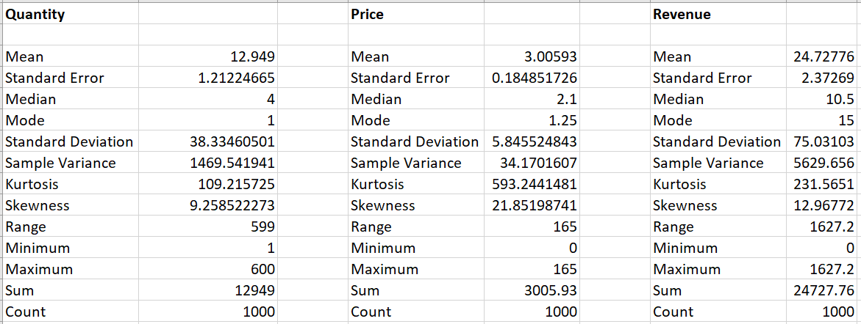
EXPLORATORY DATA ANALYSIS
Quantity: Median = 4, Max = 600 → skewed by bulk orders
Price: Median = 2.1, Max = 165 → mostly low-value items, rare premium outliers
Revenue: Median = 10.5, Max = 1627.2 → skewed by wholesale invoices
Insight: Median values better represent typical sales than averages

Slide 5
DATA SEGMENTATION: BULK VS REGULAR
Identified distortion caused by bulk orders in averages
Split dataset into Bulk Segment (large wholesale purchases) and Regular Segment (small retail orders)
Built pivot tables for top 10 products in each segment
Converted pivots into matrix format for Orange analysis
Insight: Segmentation ensures clearer insights by separating wholesale vs retail behavior

Slide 6
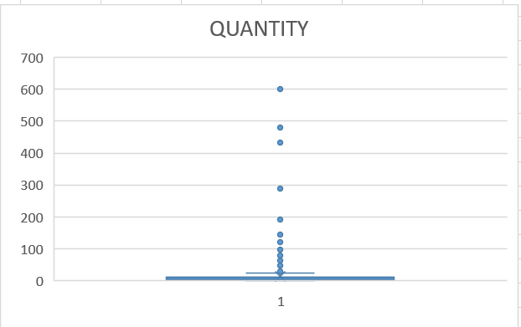
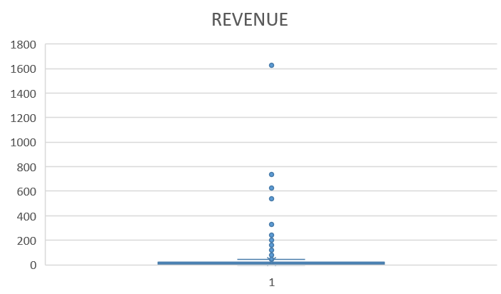
BULK VS REGULAR IDENTIFICATION
THE BOX PLOT IDENTIFIES THE OUTLIERS WHICH ARE LATER IDENTIFIED AS VALID BULK ORDERS.

Slide 7
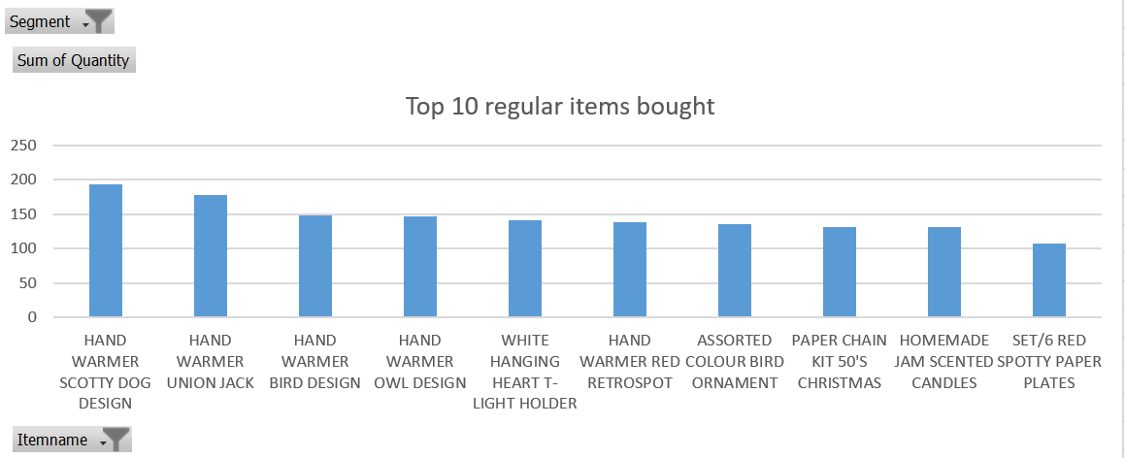
OCCURRENCE ANALYSIS- REGULAR
Top items: hand warmers (Scotty Dog – 194, Union Jack – 178), candles, ornaments
Decorative items like WHITE HANGING HEART T-LIGHT HOLDER show strong recurrence
Insight: Regular buyers prefer small, affordable, repeat-purchase items

Slide 8
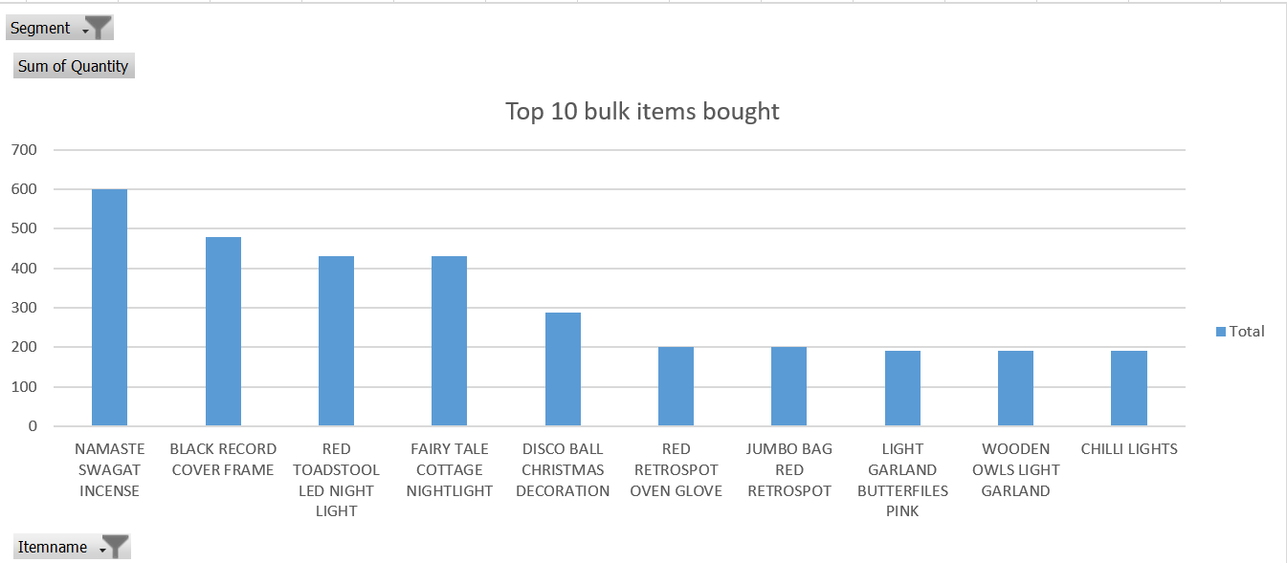
OCCURRENCE ANALYSIS - BULK
Top items: incense (600), frames (480), night lights (432)
Decorative lighting and seasonal stock drive wholesale demand
Insight: Bulk buyers prefer high-volume decorative/utility items

Slide 9
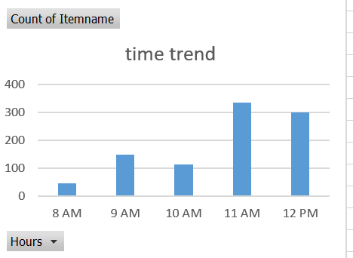
TREND ANALYSIS – BY HOURS
Bulk: Bulk orders spread across day, less time-sensitive.
Regular: Midday surge (11 AM–12 PM) with peak item counts.
Overall Insight: Promotions should target retail midday peaks; bulk timing less critical.

Slide 10
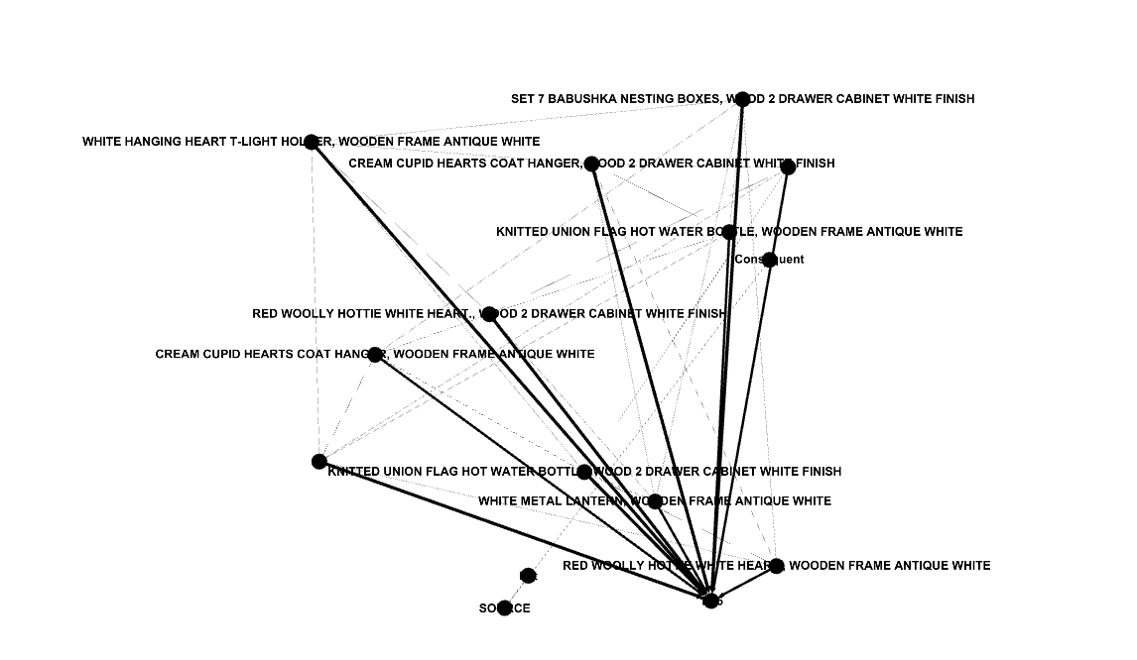
ASSOCIATION ANALYSIS - REGULAR
Apriori reveals associations among small gift items
Example: hand warmers + candles
Insight: Rules highlight cross-sell opportunities for retail
Apriori reveals associations among small gift items.
Example: hand warmers + candles.
Insight: Rules highlight cross-sell opportunities for retail.

Slide 11
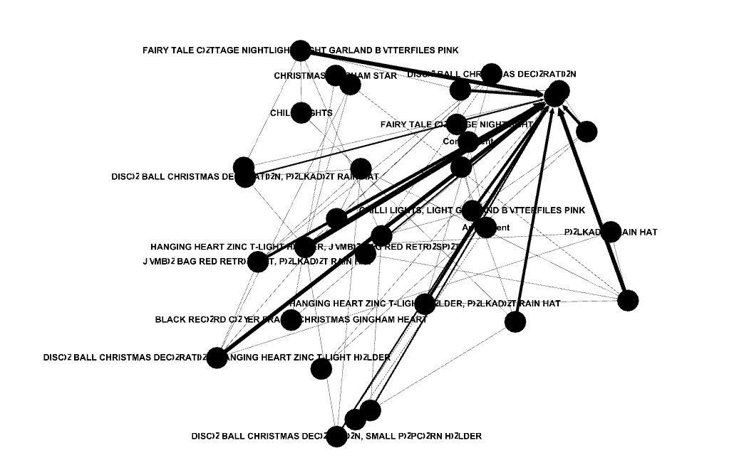
ASSOCIATION ANALYSIS - BULK
Apriori reveals strong co-occurrence among wholesale decorative items
Example: incense + lighting bundles
Insight: Rules highlight wholesale bundling opportunities

Slide 12
RECOMMENDATIONS:
BULK ITEMS:
Maintain stock of incense, frames, lighting.
Offer wholesale discounts and bundles.
Use hubs as anchor products for cross-selling.
REGULAR ITEMS:
Keep hand warmers, candles, ornaments in steady supply.
Target midday peaks with flash sales and gift packs.

Slide 13
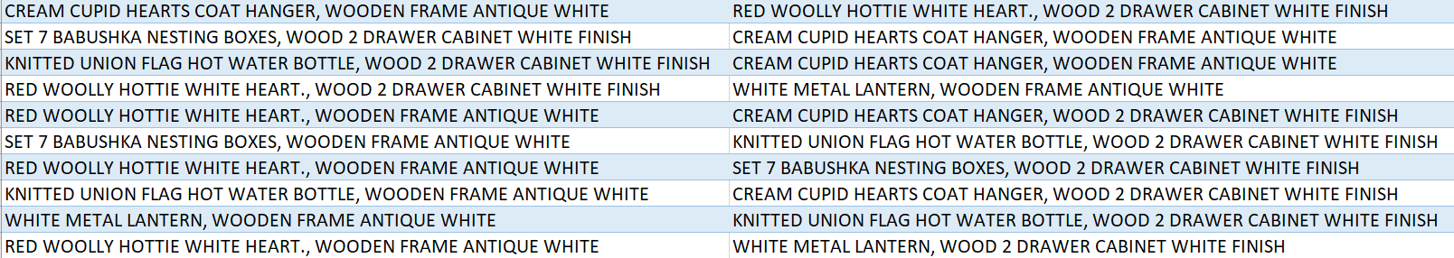
TOP REGULAR ITEMS OFFERS
ALL OF THESE ARE OF SUPPORT OVER 50% AND CONFIDENCE OF 100%.
THESE ITEMS CAN BE SOLD BOTH AS A COMBO OFFERES AND ALSO AS BUNDLES TO IMPROVE THEIR SALES.
PEOPLE MIGHT BUY WHEN IT CAN BE A “ALL-IN-ONE” BUNDLE OFFER.

Slide 14
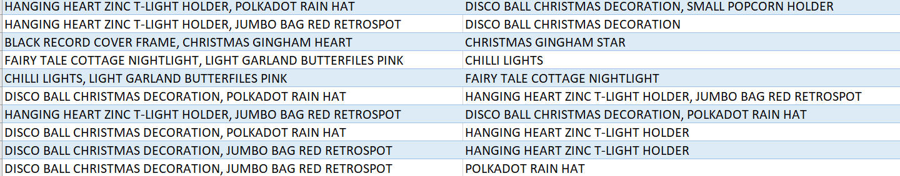
TOP BULK ITEMS BUNDLES OFFERS
ALL OF THESE ARE OF SUPPORT OVER 50% AND CONFIDENCE OF 100%.
THESE ITEMS CAN BE SOLD IN BUNDLE OFFERS IN BULKS, ESPECIALLY AS A FESTIVE-THEMED OFFERS.
BUNDLES ARE PREFFERED BY WHOLE-SAFE CONCEPT BUYERS.

Slide 15
STRATEGIC TAKEAWAYS
Dual inventory strategy (bulk vs retail)
Time promotions around midday peaks for retail.
Prioritize UK campaigns, experiment abroad.
Leverage association rules for bundles and personalization.
Expand strategically with seasonal promotions.

